Slide 1

DECISIONHUB
Management Hub for all automated decisions
Team: Debuggers
Abhishek Mallick 21051706
Aman Chaurasia 21051370
Deepraj Bera 21051302
Harshit Mania 21051398

Slide 2
PROBLEM STATEMENT
Develop a Rule Builder application that empowers Business Analysts to create, save and visualize decision strategies.
Provide a no-code rule writing experience and visual representation to test these rules in real time and observe the calculations at each step.

Slide 3

CHALLENGES
1
ENGLISH LIKE RULE WRITING
Yes/No rules
Assignment rules
Nested rules
SUPPORT FOR
ADVANCED CONDITIONALS
2
Conditions in the rule can use comparison operators like:
<, >, <=, >=, ==, !=, and, or, not
AGILITY IN QUICKLY CHANGING RULES
3
Having the ability to quickly modify and test the rules is crucial.
In the real world, these rules get way more complicated, and analysts can easily make mistakes.
DEBUGGING RULES QUICKLY
When working with 1000s of rules, analysts need an easy way to quickly check the logic of each portion of their calculations.
There is a need to run the rules quickly and double-click to figure out where the wrong condition could be present.
4

Slide 4
OUR SOLUTION
DECISIONHUB
A Cutting-edge Platform made for the business analyst to easily analyse and visualize the data.
Features:
Text to query generator
Perform complex Data Extraction
Visualize the Rules and Conditions
USE CASES:
To be written here

Slide 5
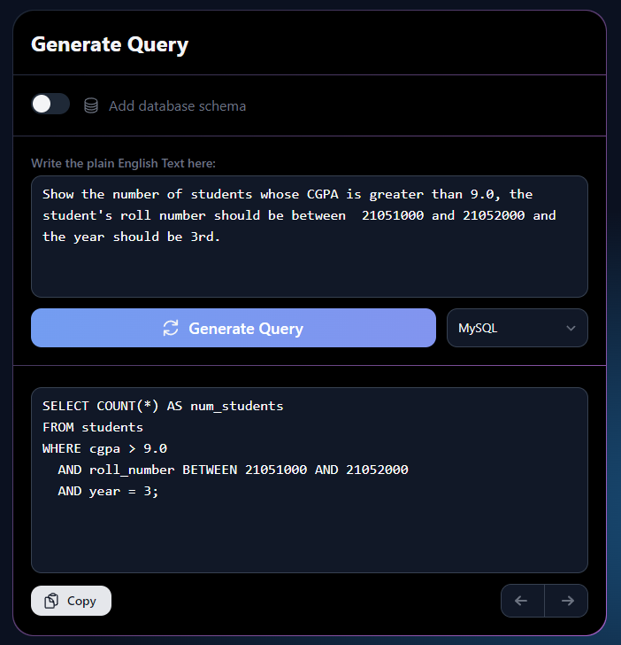
01. TEXT TO QUERY
It uses the LLM model to transform the simple plain English text into a Query that can run on various platforms to extract data from the relational database.

Slide 6
02. COMPLEX QUERY EXECUTOR

Slide 7
03. VISUALIZATION OF QUERY AND SCHEMA

Slide 8
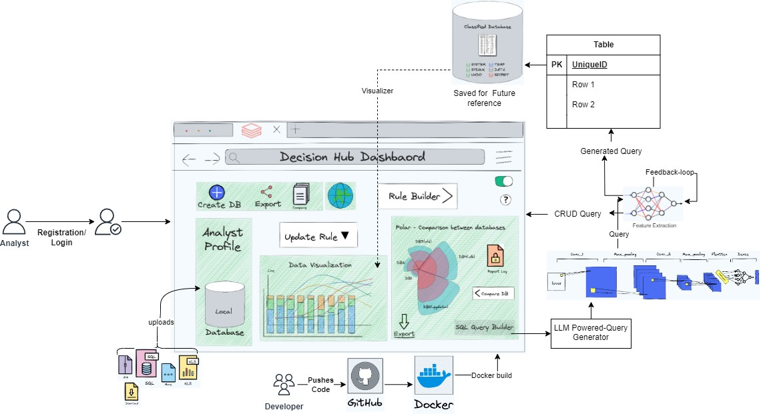
ARCHITECTURE DIAGRAM

Slide 9
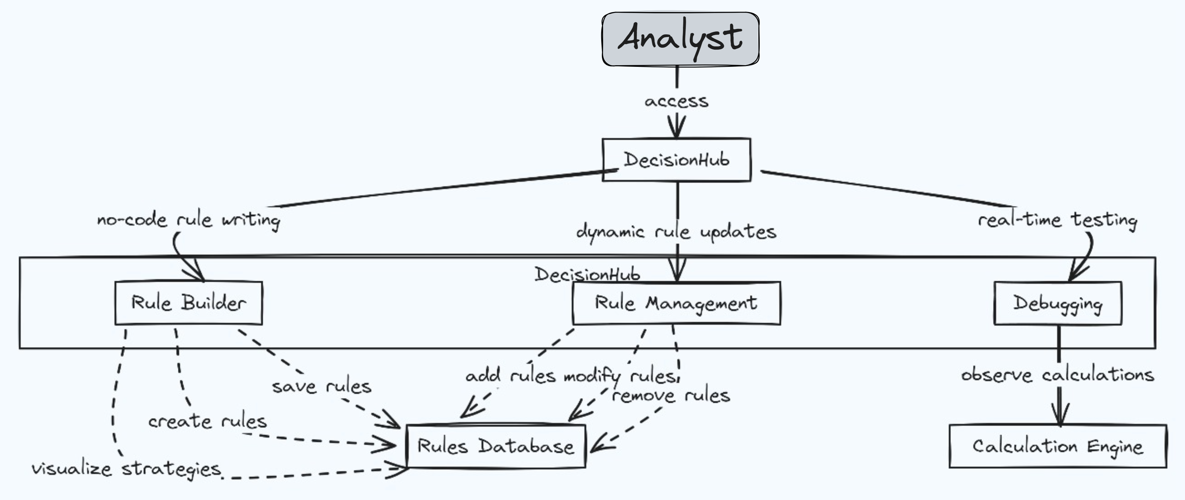
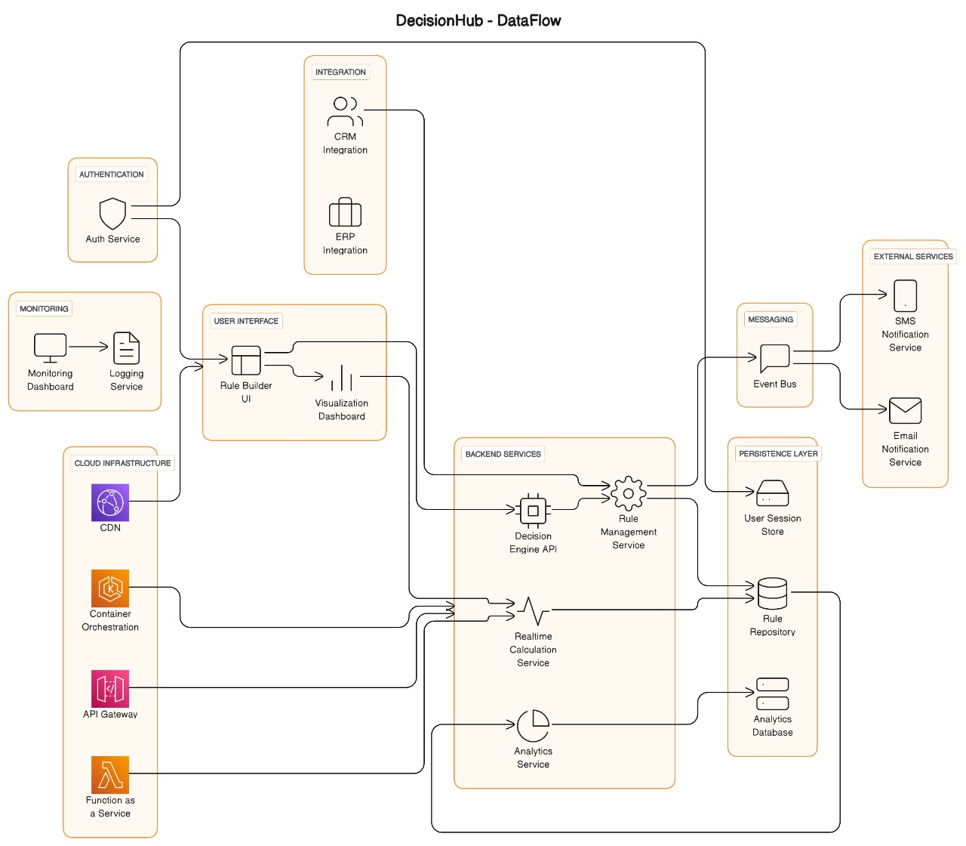
Wireframe
DataFlow

Slide 10
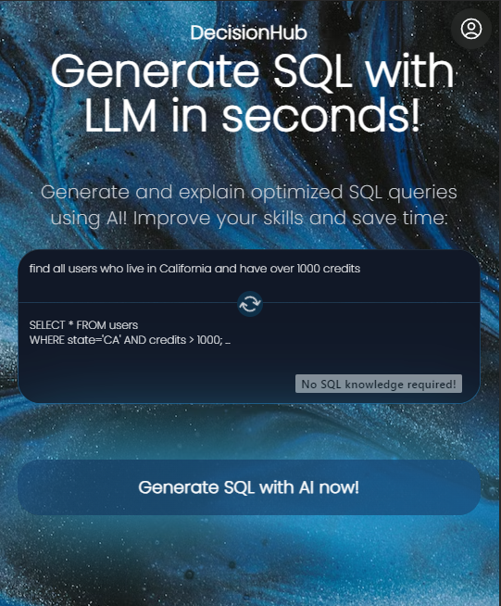
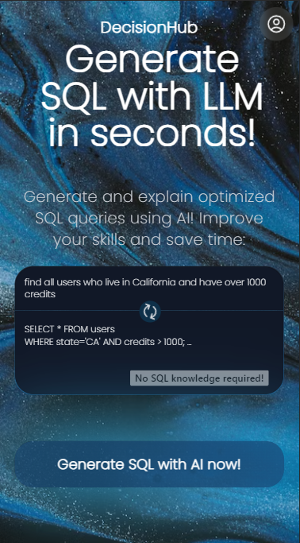
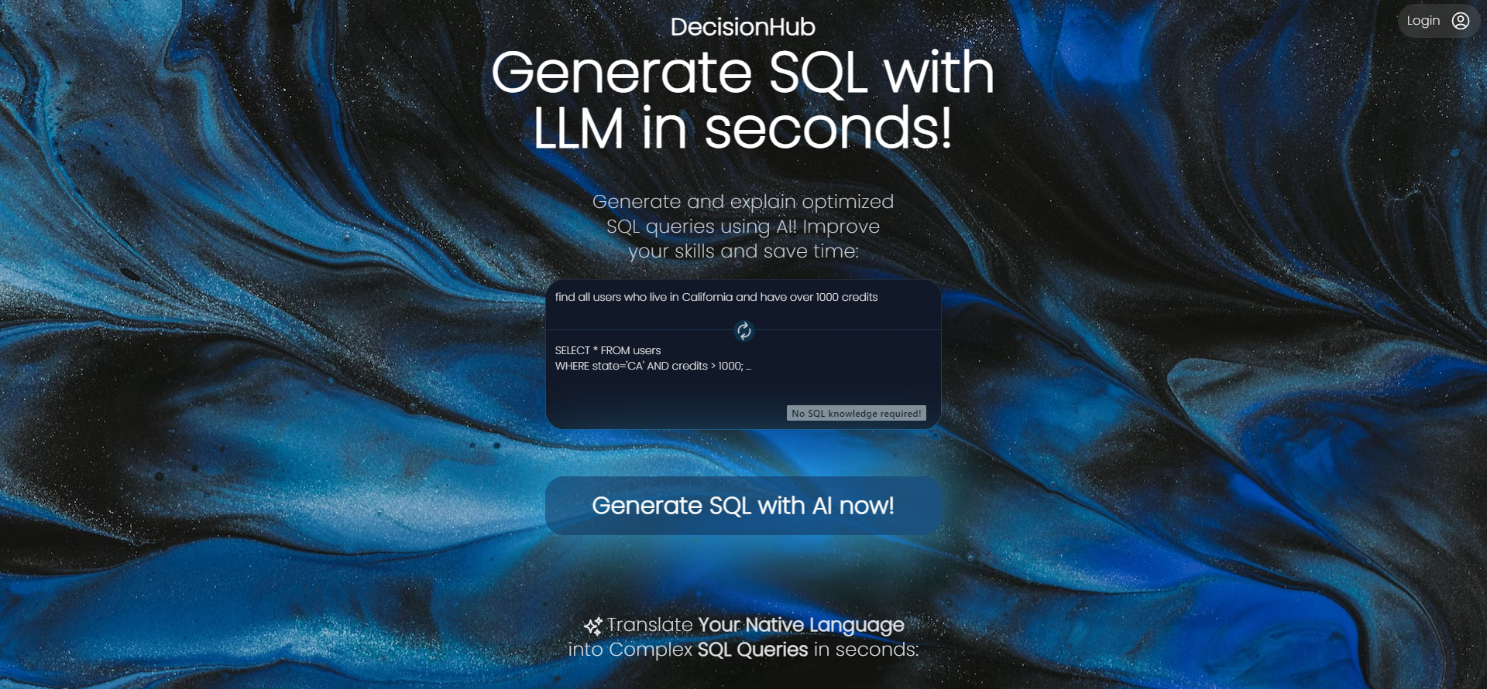
WEBAPP PREVIEW

Slide 11


THANK YOU!
Do you have any questions?
MAIL: 21051706@kiit.ac.in
Abhishek Mallick
KIIT (CSE: 3rd year)
Prototype
Report

